Slide 1
CASE STUDY 1
POLICY AGENT

Slide 2
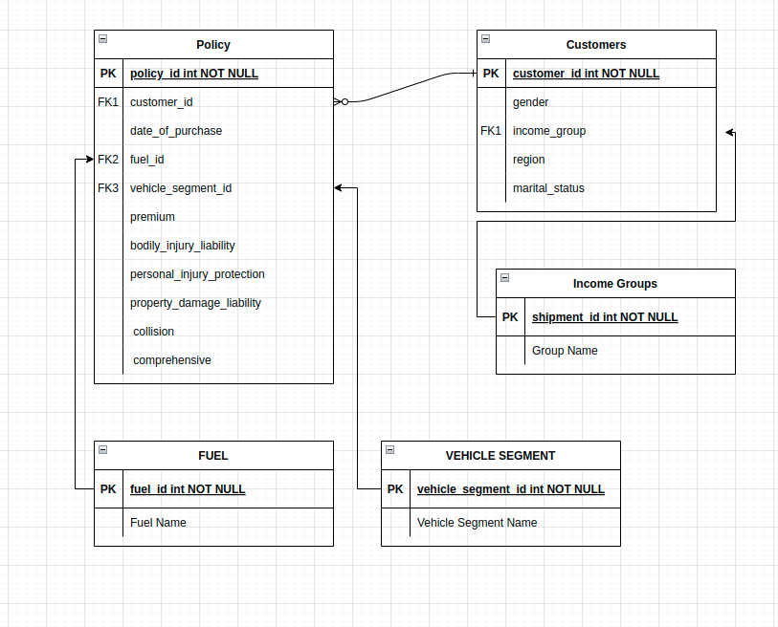
ERD

Slide 3
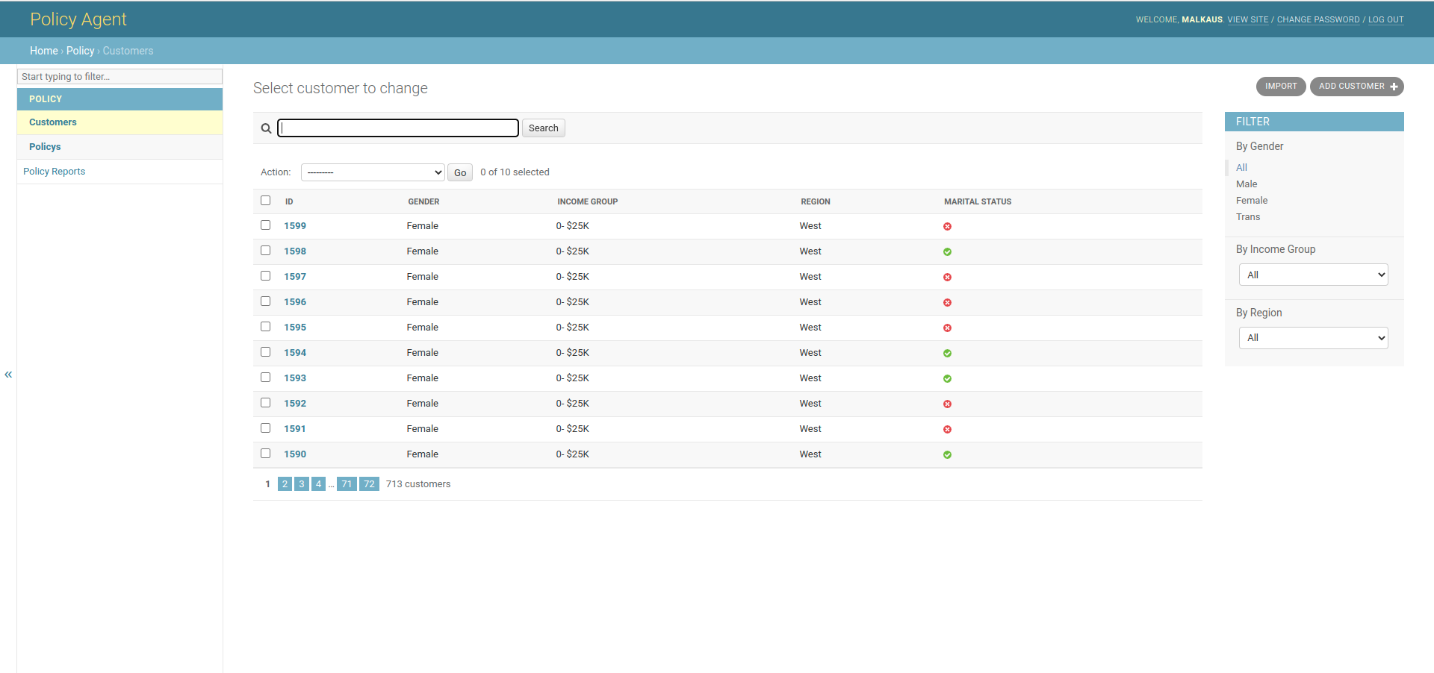
Customer List

Slide 4
About Customer List
Click on the customer id to edit details
Search bar to look up for customer id
General filters - Gender, Income Group and Region

Slide 5
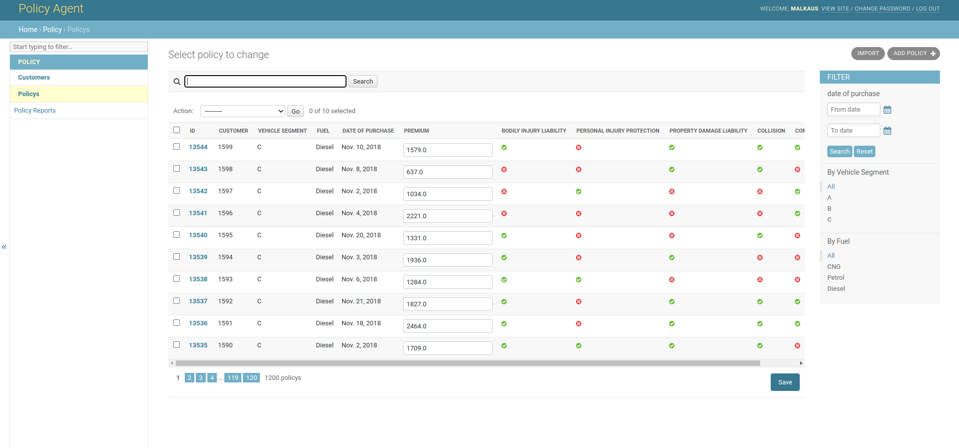
Policy List

Slide 6
About Policy List
Click on the policy id to edit details except - date of purchase and customer
Search bar to look up for customer id and policy id
General filters - Date of Purchase, Vehicle Segment and Fuel

Slide 7
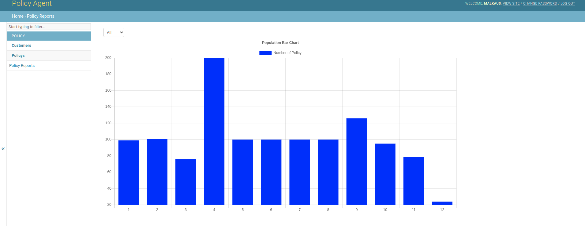
Month Wise Chart

